Slide 1

Sym
Deliverable 8 Presentation
CS 692 - Computer Science Project II
Professor Henry Wong
HiddenAgility

Slide 2






Team Member Roles
Briana Figueroa: Frontend Developer/Designer
Coded several pages of the application
Designed page layouts and various graphics
Made our web application mobile-friendly
Swapnil Kadekar: Machine Learning Engineer
Developed original machine learning algorithm
Designed backend architecture
Researched and formulated datasets for training, and performed statistical analysis
Morgan Franklin: Cloud Engineer
AWS Administrator
Provisioned code collaboration and cloud services
Documented test cases and co-authored technical paper
Alan Singleton: Full-Stack Developer
Incorporated APIs such as Google Maps and Dialogflow
Optimized application code for modularity
Developed logic for advance prediction pages
Sayema Islam: Product Owner/Lead Developer
Originator of SymCheck
Reviewed code for accuracy and assisted with debugging
Authored technical documentation and maintains project’s GitHub repository and Wiki
Jasmine Washington: Scrum Master/Project Manager
Led team meetings and kept team on task
Assisted with frontend and backend development
Co-authored technical paper and maintains project’s GitHub repository and Wiki
HiddenAgility

Slide 3
Agenda
Project Description
Personas
Team Members
Requirements
Sprint 1-7 Recap
Sprint 8
Retrospectives
Conclusion
Statistics
Statistics
Artifacts
Test Cases
Burndown Chart
Deliverables
Artifacts
Burndown Charts
Deliverables
GitHub Wiki
Design Architecture
Front-end Technologies
Back-end Technologies
AWS Services
HiddenAgility

Slide 4
Project Description
HiddenAgility

Slide 5

What is ?
An image-based, self-diagnosis web application
A patient’s uploaded image is analyzed by an original algorithm
This algorithm was developed, tested, and is run using TensorFlow's Keras library
SymCheck diagnoses two (2) illnesses: chickenpox (varicella) and pink eye (conjunctivitis)
SymCheck helps in saving patients time by avoiding potentially unnecessary healthcare visits
The use of SymCheck can help in mediating the spread of COVID-19 by reducing traffic in Urgent Care and other healthcare facilities
Application does not require account creation or login, nor answering long series of monotonous questions (image-based)
HiddenAgility

Slide 6

Persona 1: Cindy the Single, Working Mother
Background Profile:
Cindy is a 32-year old single mother with 2 boys: Adrian (4 years old) and Simon (6 years old). She also has a full-time job as a business analyst, working around 80 hours a week.
Simon has recently developed a rash on his chest. Cindy called the family's pediatrician to seek a quick diagnosis, but they are reluctant to diagnose him without a physical visit.
How can SymCheck help?
Cindy could very much use an application to get a cursory diagnosis of her son's symptoms from the comfort of her own home or work-desk. This would allow her to potentially save an unnecessary visit and follow recommendations listed on the SymCheck site, or even shorten a visit to the doctor by simply having him verify the result in confidence.

Slide 7

Persona 2: Ryan the overwhelmed college student
Background Profile:
Ryan is a junior at Pace University. Not only is he swarmed with assignments, but he has also just started to notice strange skin lesions on his arm. Although he wants to get his skin checked, he just doesn’t have time to waste in his schedule to check in to a doctor's office or urgent care facility if it is not necessary.
How can SymCheck help?
Ryan needs a cursory method of diagnosis for his skin abnormality, without having to pay a physical visit to some medical facility.
Our SymCheck application can solve this dilemma, and if the application identifies his lesions as to being serious or even life-threatening, it can recommend that he definitively needs to prioritize a visit to the doctor or nearest hospital.

Slide 8

Persona 3: Lisa the Caring Nurse
Background Profile:
Lisa has 15 years of experience as a Nurse at various urgent care facilities. Now, during global COVID-19 pandemic, many of her patients complain to her about the waiting period to see a doctor.
How can SymCheck help?
In order to help minimize the number of patients in the office, Lisa seeks an application to help her patients determine whether or not their illness symptoms require immediate medical attention.
Given that Lisa wishes to refer her patients to a reliable, and convenient source of diagnosis, the SymCheck application could potentially offer guidance in determining what a patient's symptoms may indicate and thus provide recommendations for at-home remedies.
The use of SymCheck could thus also help in mediating the spread of COVID-19 by reducing the traffic in Urgent Care facilities.

Slide 9
SymCheck Requirements
Upload Image
.png and .jpg/.jpeg files only
Receive Image-based Results
Quicker results for the patient
Receive Advanced Results
More accurate results for the patient
Find Nearest Emergency Room
Accurate geolocation for nearby hospitals/healthcare facilities
Interactive Chatbot
Quick replies to commonly asked questions

Slide 10
Design Architecture: Front-end Technologies & AWS Services
HiddenAgility

Slide 11



Front-end Technologies
Presentation and dynamic coding languages that affect the content, style and interactivity of our web application
An API that creates a custom and searchable map based on a user’s location
A natural language AI platform that makes it easy to design and integrate a chatbot into a web application
HiddenAgility

Slide 12




AWS Services
AWS Elastic Beanstalk
AWS Cloud9
AWS Certificate Manager (ACM)
Amazon Route 53
Easy service for deploying and scaling web applications
Cloud-based integrated development environment (IDE) that allows us to write, run, and debug SymCheck
A service that allows us to easily provision and deploy Secure Sockets Layer/Transport Layer Security (SSL/TLS) certificates.
A highly available and scalable cloud Domain Name System (DNS) web service.
www.symcheckapp.com
HiddenAgility

Slide 13









SymCheck AWS Diagram
AWS Cloud
Elastic Beanstalk container
Users
Availability Zone
M5 instance
Mobile client
Client
Application Load Balancer
Availability Zone
Auto scaling
M5 instance
Amazon Route 53
https://www.symcheckapp.com
HiddenAgility

Slide 14
Design Architecture: Back-end Technologies
HiddenAgility

Slide 15



Back-end Technologies
Server-side web application framework that is written in Python
Allows simple design and rapid development
Open-source library for various machine learning models
Uses Python for its frontend API and executes applications in C++
A high-level API embedded within TensorFlow
User-friendly, and provides ”out-of-the-box” implementations of common network structures
HiddenAgility

Slide 16
SymCheck Django Diagram
Django
D
Template (HTML, CSS, JS)
Views
NewHomepage
NewUploadpage
NewFAQpage
NewAboutUspage
NewResultspage
Model
NewSymcheckModel.h5
App
ebdjango
Media Folder
HiddenAgility

Slide 17
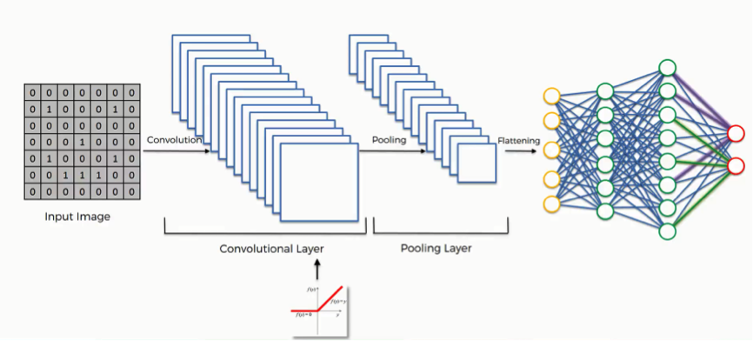
Machine Learning Algorithm
CNN -
A Convolutional Neural Network (CNN) is a Deep Learning algorithm which can take in an input image, assign importance like learnable weights and biases to various aspects in the image and be able to differentiate one from the other.
The pre-processing required in a CNN is much lower as compared to other classification algorithms. with enough training, CNN have the ability to learn the characteristics.

Slide 18
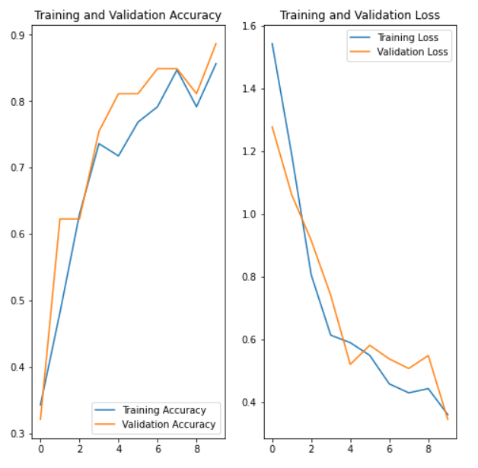
Model Evaluation
Model Evaluation is an integral part of the model development process. It helps to find the best model that represents our data and how well the chosen model will work in the future.
Training and Validation accuracy
Training – 85.63%
Validation – 88.68%

Slide 19
Sprint 1-3 Recap
HiddenAgility

Slide 20
Sprint 1 Artifacts
100%
Completed Artifacts
Type | Key | Summary | Story Points | Priority | Status
Task | HID-46 | Create a significant business application idea | N/A | Highest | Done
Task | HID-1 | Project Survey | N/A | Highest | Done
Task | HID-49 | Establish weekly meetings | N/A | Medium | Done
Task | HID-48 | Establish team roles | N/A | Medium | Done
Task | HID-47 | Set up development tools (GitHub and Jira) | N/A | Medium | Done
Task | HID-45 | Create Deliverable 1 Presentation | N/A | Medium | Done
We established team dynamics and our application idea
HiddenAgility

Slide 21
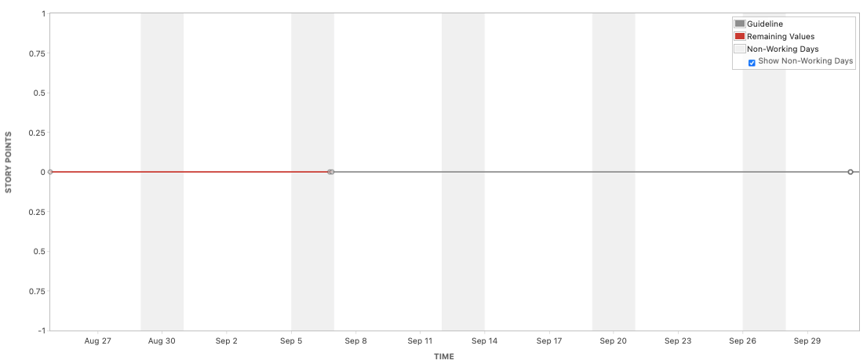
Sprint 1 Burndown Chart
We did not have any user stories documented
HiddenAgility

Slide 22
Sprint 2 Artifacts
100%
Completed Artifacts
Type | Key | Summary | Story Points | Priority | Status
Task | HID-13 | Create mock-up web designs | N/A | Highest | Done
Task | HID-12 | Complete Deliverable 2 PowerPoint Presentation | N/A | High | Done
Task | HID-11 | Complete Acceptance Criteria | N/A | High | Done
Task | HID-10 | Research Django Framework | N/A | High | Done
Task | HID-9 | Complete Test Cases | N/A | High | Done
Task | HID-8 | Complete User Stories | N/A | High | Done
We documented our user stories, acceptance criteria and test cases
We drafted our first SymCheck designs
HiddenAgility

Slide 23
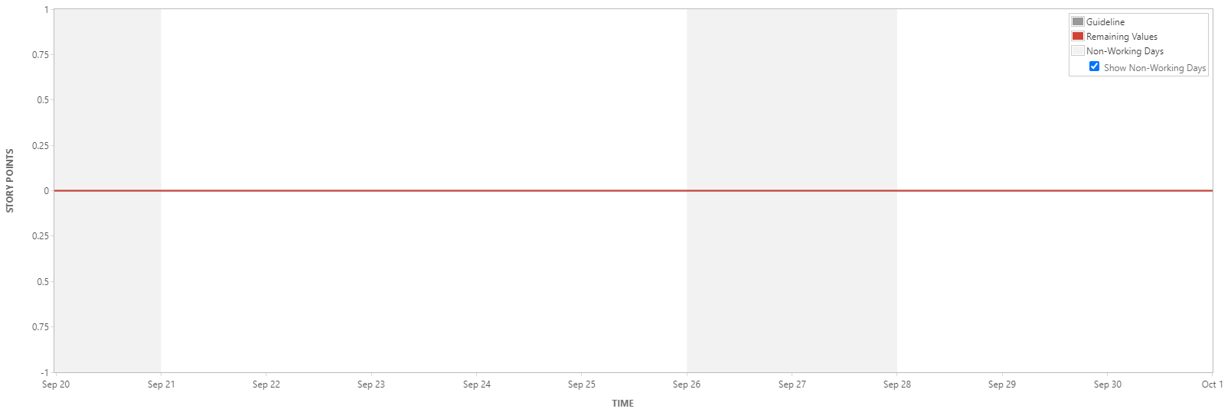
Sprint 2 Burndown Chart
We did not have any user stories documented
HiddenAgility

Slide 24
Sprint 3 Artifacts
67%
Completed Artifacts
4
Velocity
Type | Key | Summary | Story Points | Priority | Status
Story | HID-44 | As a patient, I want to get in touch with the creators of the SymCheck application so that I can provide the creators of the SymCheck application with suggestions/comments, ask them questions, commend them for their product, etc. | 2 | Medium | Done
Story | HID-36 | As a patient, I want to return to the homepage so that I can re-read the SymCheck mission statement, disclaimer, etc. | 1 | Medium | Done
Story | HID-35 | As a patient, I want to find the nearest emergency room so that I can seek immediate medical condition for what I deem to be an extremely critical/dire/time-sensitive condition | 3 | Medium | Moved to Sprint 4
Story | HID-32 | As a patient, I want to be sure that my image has been uploaded successfully so that I can be sure that the image will be processed by the application so that I can receive recommendations for my care | 3 | Medium | Moved to Sprint 4
Story | HID-31 | As a patient, I want to upload a photo/image of my symptom/affected area/illness so that the SymCheck application can diagnose me and I can gain insights as to what I might be afflicted with | 3 | Medium | Moved to Sprint 4
Story | HID-30 | As a patient, I want to be diagnosed by the SymCheck web application so that I can gain a cursory understanding of what might be causing my symptoms/what the potential recommendations might be | 1 | Medium | Moved to Sprint 4
Story | HID-29 | As a patient, I want to know that I have reached the correct page to use the SymCheck application so that I can be sure I am uploading my picture to the correct place and receiving the recommendations/care that I desire | 1 | Medium | Done
Type | Key | Summary | Story Points | Priority | Status
Task | HID-28 | Create Google API Account | N/A | Medium | Done
Task | HID-24 | Develop illness result page | N/A | Medium | Done
Task | HID-23 | Develop illness prediction image upload page | N/A | Medium | Done
Task | HID-22 | Develop Home page | N/A | Medium | Done
Task | HID-17 | Complete IEEE style technical paper (Deliverable 3) | N/A | Medium | Done
HiddenAgility

Slide 25
Sprint 3 Test Cases
100%
Completed Artifacts
Test Case For | Key | Test Cases | Expected Results | Actual Results | Pass/Fail
Results | HID-44 | Feedback | Patient can send feedback through SymCheck email or social media | In the footer there is a contact us section, where you can send feedback through an email or via social media | Pass
Upload page | HID-36 | Return to Homepage Link | Patient should be able to return to the homepage when clicking Home | At the top of the page within the NavBar when selecting Home, you are redirected to the homepage of Symcheck | Pass
Homepage | HID-29 | Browse the Website | Patient should be able to access the homepage of the website | Once directed to site, you will first be directed to the homepage of SymCheck | Pass
HiddenAgility

Slide 26
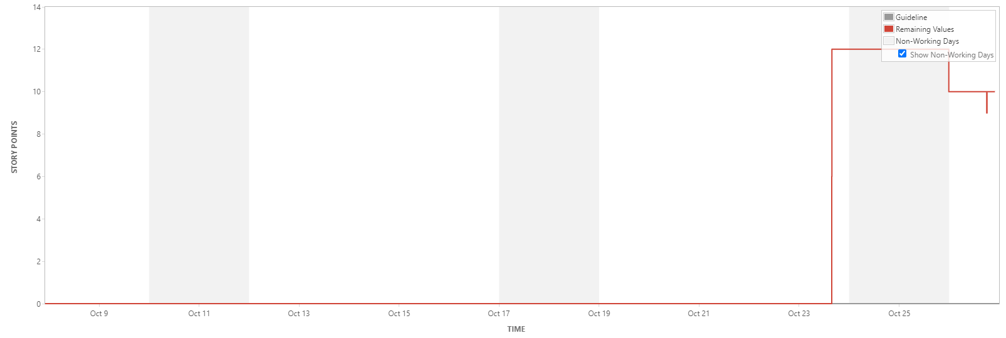
Sprint 3 Burndown Chart
We completed our work towards the end of the Sprint.
HiddenAgility

Slide 27
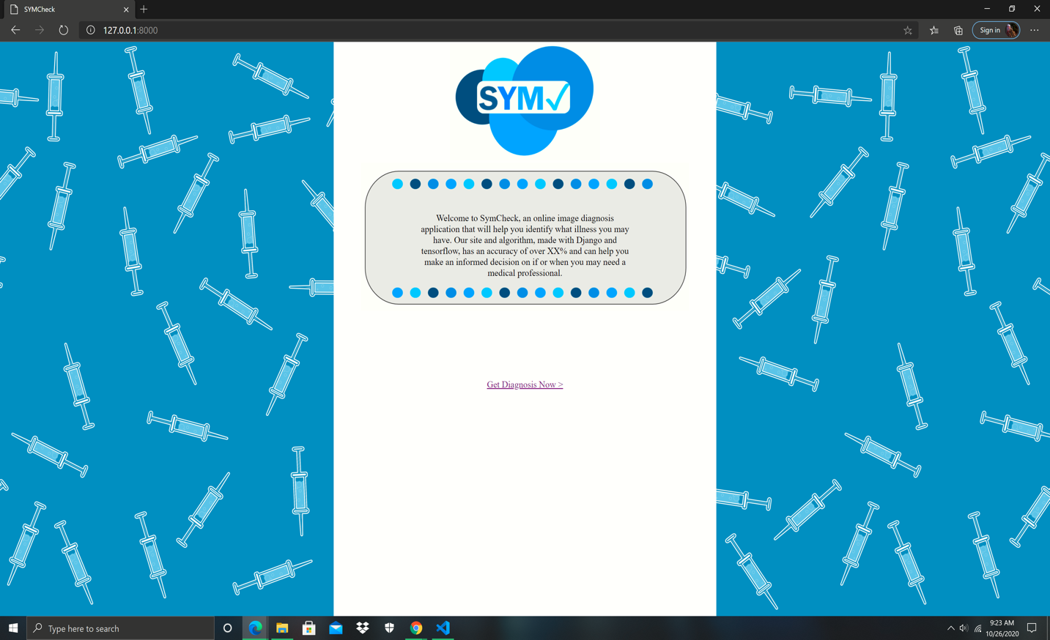
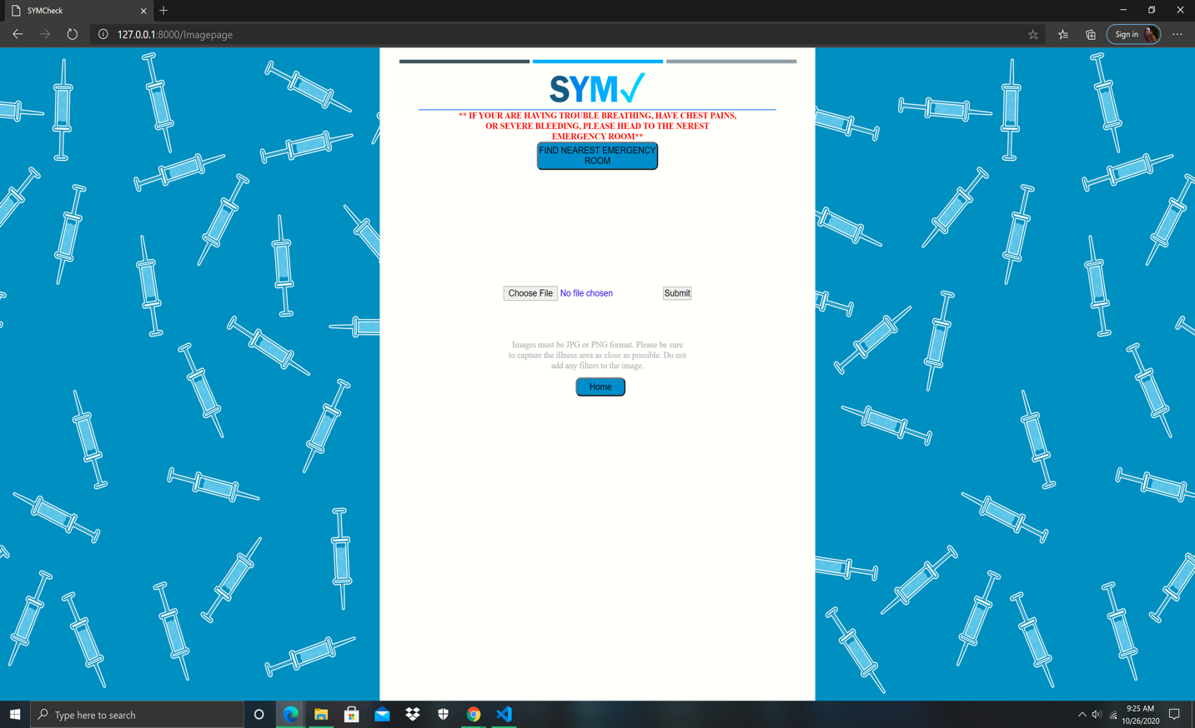
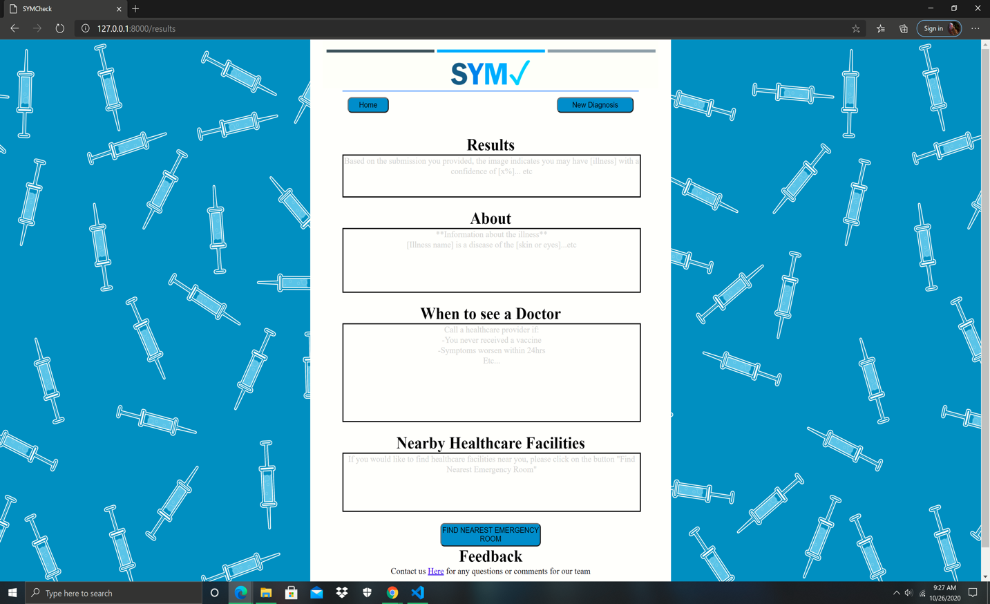
Sprint 3 Deliverable
Completed SymCheck welcome page (top-left)
Progress on image upload page (top-right)
Established framework for final results page, and completed SymCheck feedback form link (bottom)
This Sprint also saw the delivery of our first complete Technical Paper draft
HiddenAgility

Slide 28
Sprint 4-7 Recap
HiddenAgility

Slide 29
Sprint 4 User Stories
100%
Completed Artifacts
36
Velocity
Type | Key | Summary | Story Points | Priority | Status
Story | HID-43 | As a patient, I want to be aware of the quality/accuracy of the results given relative to those from a medical facility/medical professional so that I do not forget that all results are simply cursory recommendations based on past data | 1 | Medium | Done
Story | HID-41 | As a patient, I want to receive another diagnosis for another affliction/repeat the diagnosis for this one so that so that I can upload another photo/set of symptoms for a different or the same illness (i.e. for confirmation of the latter) | 1 | Medium | Done
Story | HID-39 | As a patient, I want to know whether or not I should see a doctor so that I can gauge how much of a PRIORITY a visit to a doctor/medical facility is based on the general nature of my symptoms/illness/affliction | 5 | Medium | Done
Story | HID-38 | As a patient, I want to know what information I can obtain about this/any illness I might potentially have so that I can gain an understanding of what might be causing my symptoms, and thus make an informed decision on how best to go forth with my care | 5 | Medium | Done
Story | HID-37 | As a patient, I want to know what my symptoms indicate/what my affliction might be so that I can gain an understanding of what might be causing my symptoms, and thus make an informed decision | 5 | Medium | Done
Story | HID-35 | As a patient, I want to find the nearest emergency room so that I can seek immediate medical condition for what I deem to be an extremely critical/dire/time-sensitive condition | 3 | Medium | Done
Story | HID-34 | As a patient, I want to know if I am in a critical condition or in need of immediate medical attention so that I am able to seek medical care as soon as possible if there is no time to waste! | 1 | Medium | Done
Story | HID-33 | As a patient, I want to submit my image for assessment so that I may receive a[n accurate] determination of my affliction as well as recommendations for care | 8 | Medium | Done
Story | HID-32 | As a patient, I want to be sure that my image has been uploaded successfully so that I can be sure that the image will be processed by the application so that I can receive recommendations for my care | 3 | Medium | Done
Story | HID-31 | As a patient, I want to upload a photo/image of my symptom/affected area/illness so that the SYMCheck application can diagnose me and I can gain insights as to what I might be afflicted with | 3 | Medium | Done
Story | HID-30 | As a patient, I want to be diagnosed by the SYMCheck web application so that I can gain a cursory understanding of what might be causing my symptoms/what the potential recommendations might be | 1 | Medium | Done
HiddenAgility

Slide 30
Sprint 4 Tasks
100%
Completed Artifacts
Type | Key | Summary | Story Points | Priority | Status
Task | HID-7 | Upload ML algorithm code onto Jira Documents Page | N/A | Highest | Done
Task | HID-55 | Finish draft technical paper | N/A | Medium | Done
Task | HID-54 | Update GitHub page | N/A | Medium | Done
Task | HID-53 | Complete test cases with actual results | N/A | Medium | Done
Task | HID-52 | Create installation guide for running our project on localhost | N/A | Medium | Done
Task | HID-51 | Create a user manual for using SymCheck application | N/A | Medium | Done
Task | HID-50 | Create Deliverable 4 PowerPoint Presentation | N/A | Medium | Done
Task | HID-27 | Research Database options (AWS3) | N/A | Medium | Done
Task | HID-24 | Develop illness result page | N/A | Medium | Done
Task | HID-23 | Develop illness prediction image upload page | N/A | Medium | Done
Task | HID-21 | Create a video showing our MVP demo | N/A | Medium | Done
Task | HID-16 | Develop Image Classification ML Algorithm | N/A | Medium | Done
HiddenAgility

Slide 31
Sprint 4 Test Cases (Homepage and Upload page)
100%
Completed Artifacts
Test Case For | Key | Test Cases | Test Data | Expected Results | Actual Results | Pass/Fail
Homepage | HID-30 | Locate the Upload Image Link |  | Patient should be able to locate the link to access the upload page | Click link Upload Images or the Upload in NavBar to be redirected to upload page | Pass
Upload page | HID-30 | Locate the Upload Image Link |  | Patient should be able to locate the link to upload image | Once redirected to Upload Page the patient can easily find the Upload Image button where they can upload an image for diagnosis | Pass
Upload page | HID-31 | Locate the Submit Photo Link |  | Patient should be able to locate the link to submit photo | Once redirected to the Upload Page beside to the upload image button there is a button to submit the photo | Pass
Upload page | HID-31 | Choose file shows up | chickenpox image file | Patient should see choose file option, to upload photo to website | Once you click the choose file button you will be redirected to upload a file from your computer | Pass
Upload page | HID-32 | Ability to cancel uploading file |  | Patient should be able to cancel the file from being uploaded | When selecting the file to upload you are prompted with the option to cancel. If you click cancel the file won't upload to the page. | Pass
Upload page | HID-32 | Verify file is uploaded |  | Patient should not be able to click on the submit button without submitting a file | If you try to select the submit button with uploading an image, you are prompted to please select a file | Pass
Upload page | HID-32 | Verify file is correct |  | Patient should be promoted to verify uploaded file is correct | When uploading the file, the patient can see what image they are uploading and cancel the process if it is not the right image. | Pass
Upload page | HID-33 | Submit to website for analysis |  | Patient should be able to click submit to send correct photo to be analyzed | Once uploading the image click the submit button and the algorithm begins analyzing the photo for results | Pass
Upload page | HID-35 | Locate the Nearest ER Link |  | Patient should be able to locate and click the Nearest ER link to access an interactive map | Under the NavBar, there is the Nearest ER link. Clicking this button, you can access google maps to show hospitals nearby. | Pass
HiddenAgility

Slide 32
Sprint 4 Test Cases (Image functionality and Results)
100%
Completed Artifacts
Test Case For | Key | Test Cases | Expected Results | Actual Results | Pass/Fail
Image functionality | HID-32 | Check for image file extension | Patient can only upload certain types of file extensions (Verify if incorrect) | When uploading a file you can only open a jpg or png. No other extensions will be allowed to be uploaded | Pass
Image functionality | HID-32 | Check for size of the image file | If file is too large to upload, the patient must be notified | If file is too large, it will be resized to fit a specific measurement before being processed in the Machine Learning | Pass
Image functionality | HID-32 | Check for height and width | Image should be measuring a certain height | Before preprocessing is done, the image is resized to be 200 length and 200 width. That way the images are processed at the same size. | Pass
Results | HID-37 | Results Page | Patient will see results based on Advanced Page | Either after answering advanced prediction questions or skipping to results page you will see the results of the image you uploaded | Pass
Results | HID-37 | Results appear after analysis complete | Patient will see percentage that they have the illness | In the Results section it displays the likely hood of the uploaded image being an illness. | Pass
Results | HID-38 | About the disease | Patient will see facts about the disease they have been diagnosed with | If the image is likely to be Chickenpox or Pink Eye, then the About box will give information about the illness and a link to the CDC website. If the image is not likely to be chickenpox or Pink Eye, then the section will say that the algorithm isn't detecting an illness | Pass
Results | HID-39 | When to see a Doctor | Patient will see when it is best advised to see a doctor | In the When To See A Doctor section, it will state when it is best advised to seek medical attention and includes the symptoms that can occur or become worse | Pass
Results | HID-40 | Nearest ER | If selected, patient will be able to access an interactive map | At the top of the page, under the NavBar there is a Nearest Emergency Room section. Where you can click the Nearest Emergency Room button and google maps pops up with Emergency Rooms nearby your location. | Pass
Results | HID-42 | Return to Homepage | Patient should be able to return to the homepage when clicking Home | At the top of the page within the NavBar when selecting Home, you are redirected to the homepage of Symcheck | Pass
Results | HID-37 | Error Message | Patient should see an error message if there is any issue with their uploaded image. | If the patient deletes their browser history and tries to refresh the page, the results won't exist anymore and this will cause the patient to submit photo again. | Pass
HiddenAgility

Slide 33
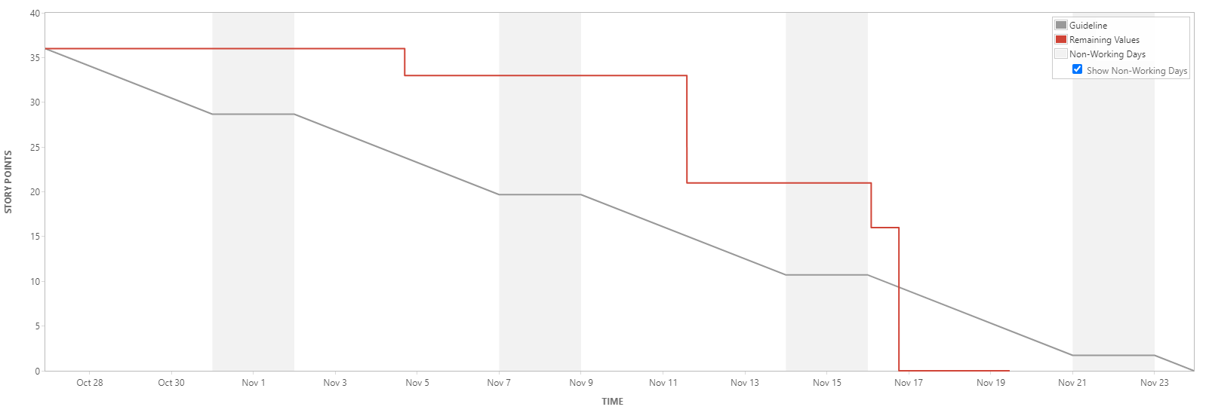
Sprint 4 Burndown Chart
We consistently completed stories and finished ahead of schedule
HiddenAgility

Slide 34
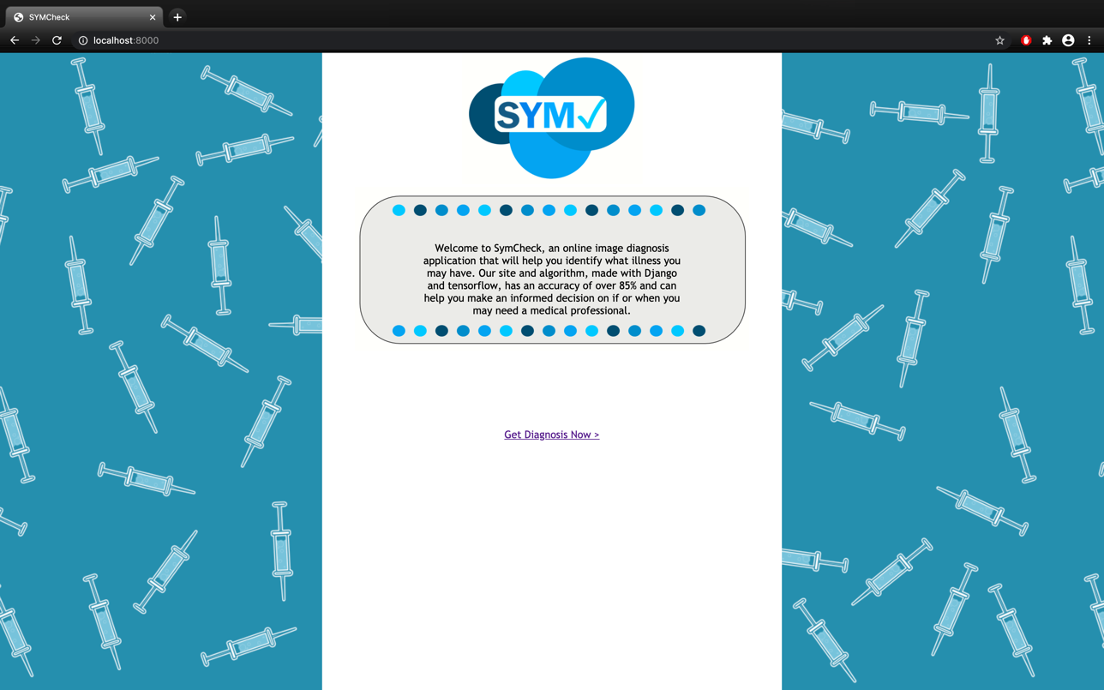
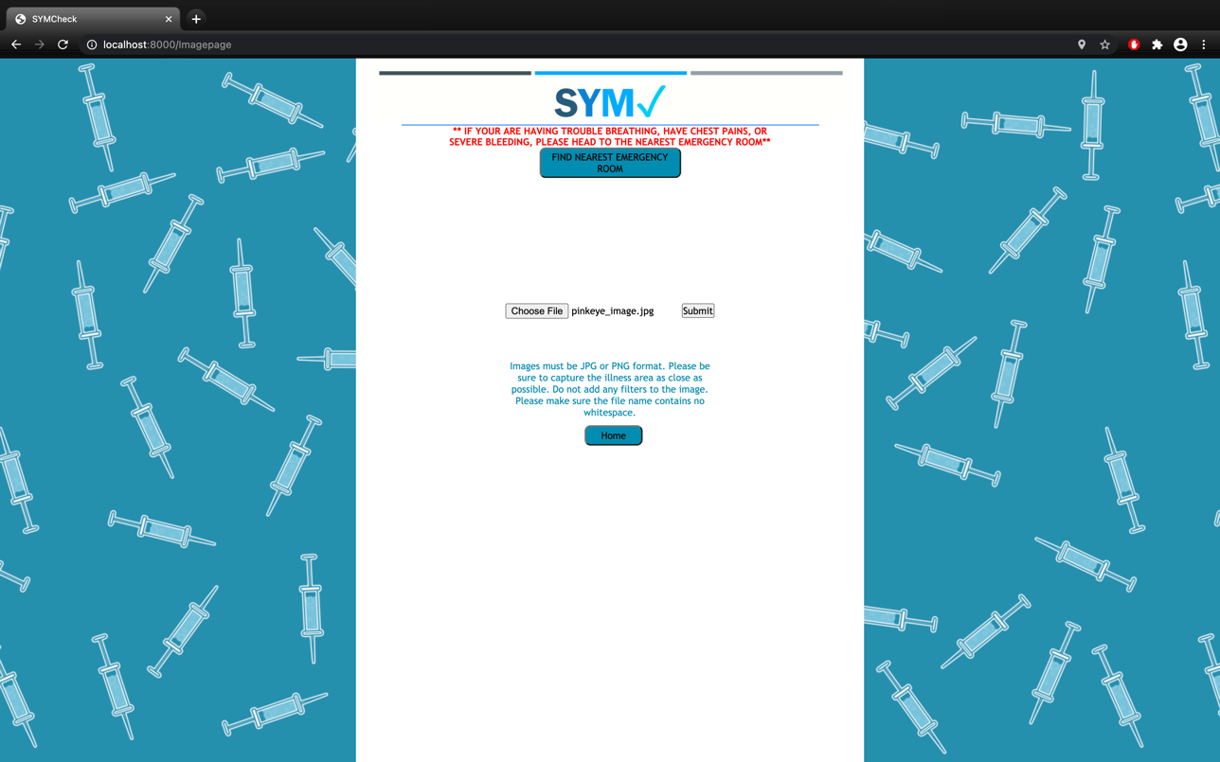
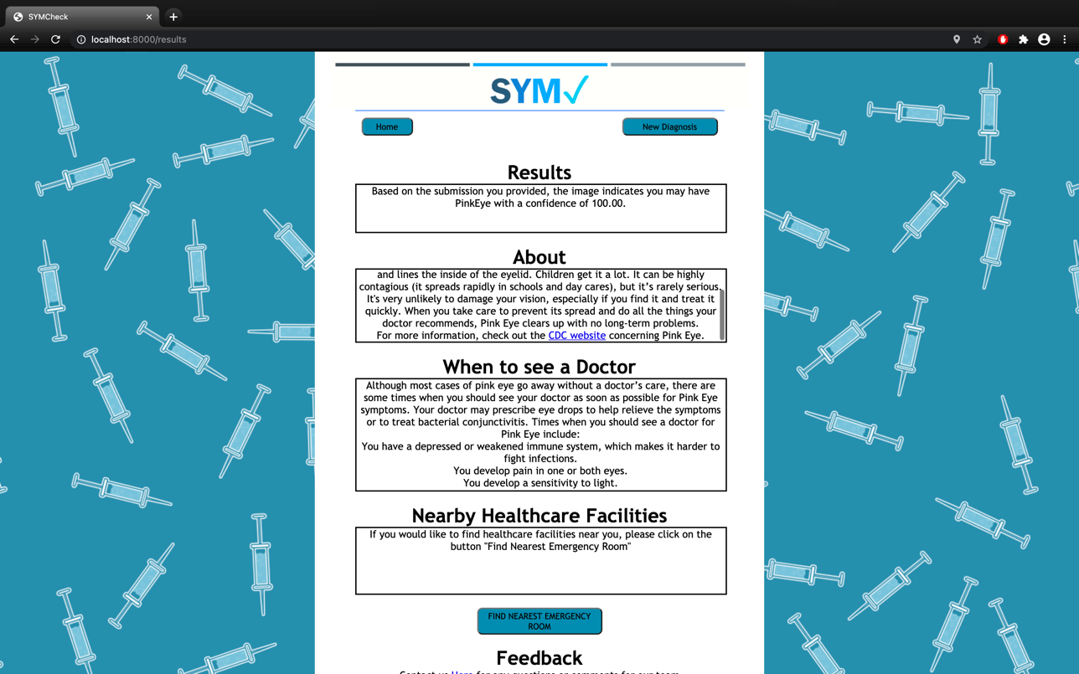
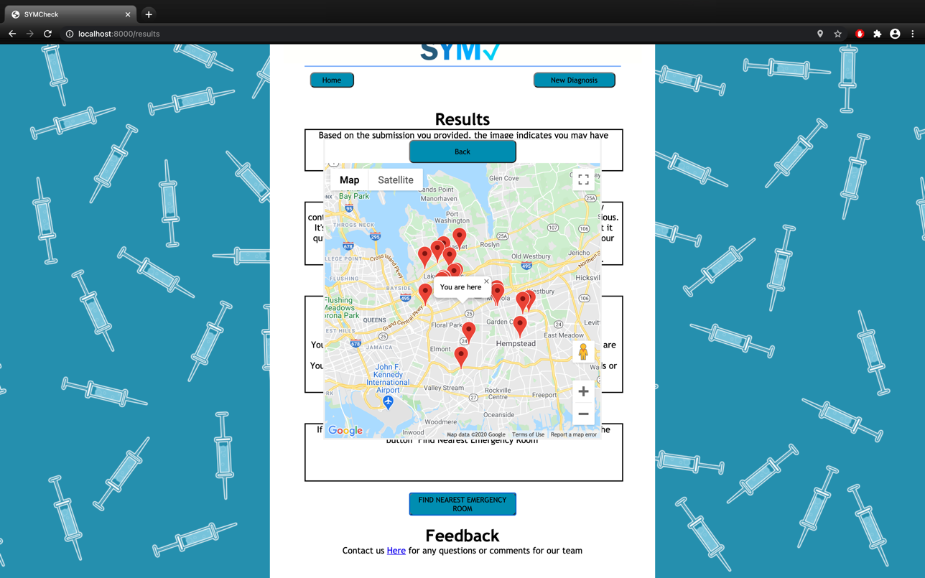
Sprint 4 Deliverable
Completed SymCheck welcome page (top-left)
Completed image upload page (top-right)
Completed results page with backend integration (bottom-left)
Completed Google Maps API integration (image upload, and results pages)
This Sprint also saw the delivery of our final Technical Paper for semester 1, as well as our completed Installation and User manuals, and GitHub Wiki
HiddenAgility

Slide 35
Sprint 5 Artifacts
100%
Completed Artifacts
14
Velocity
Type | Key | Summary | Story Points | Priority | Status
Story | HID-62 | As a patient, I want to access the SymCheck application on the web so that I don't have to download and run an instance myself | 8 | Highest | Done
Story | HID-58 | As a patient, I want to interact with the SymCheck Chat Bot so that I could have my questions answered quickly | 5 | Highest | Done
Task | HID-56 | Find more images of Chickenpox, Pink Eye, Normal skin and Normal eye for the ML algorithm | N/A | High | Done
Task | HID-74 | Find a coding collaboration tool for easier integration and editing of SymCheck | N/A | Medium | Done
Task | HID-65 | Create questions for textual diagnosis and weight priority | N/A | Medium | Done
Task | HID-63 | Enhance the SymCheck application by cleaning up code | N/A | Medium | Done
Story | HID-57 | As a patient, I want to see the image I uploaded so that I know I chose the intended file | 1 | Medium | Done
Task | HID-61 | Redo all stories, test cases, and acceptance criteria's to reflect proper type of user and verbiage | N/A | Low | Done
Task | HID-60 | Link all user stories, test cases, and acceptance criteria together | N/A | Low | Done
Task | HID-66 | Create a presentation for Sprint 5 | N/A | Lowest | Done
We hosted our application on Repl.it
We incorporated Dialogflow into our application as a ChatBot
We drafted advance prediction questions
HiddenAgility

Slide 36
Sprint 5 Test Cases
100%
Completed Artifacts
Test Case For | Key | Test Cases | Test Data | Expected Results | Actual Results | Pass/Fail
Homepage | HID-58 | Chatbot | Hi, chicken pox, pink eye | Patient can interact with SymBot and receive a response | SymBot responds on all patient inputs such as hello, what is chickenpox, how can I speak to creaters of symcheck, etc. | Pass
Image Upload Page | HID-57 | Image reflection | pinkeye image file | Patient can see their uploaded image | After you select an image to upload, the page shows you the uploaded image | Pass
Image Upload Page | HID-58 | Chatbot | How do I upload an image? | Patient can interact with SymBot and receive a response | SymBot responds on all patient inputs such as hello, what is chickenpox, how can I speak to creators of symcheck, etc. | Pass
Results | HID-58 | Chatbot | How can I get in touch with developers? | Patient can interact with SymBot and receive a response | SymBot responds on all patient inputs such as hello, what is chickenpox, how can I speak to creators of symcheck, etc. | Pass
Cloud Access | HID-62 | Access via URL | https://symcheck.jazzymaya.repl.co/ | Patients can use SymCheck without any issues | Patients can use SymCheck without any issues | Pass
HiddenAgility

Slide 37
Sprint 5 Deliverables
New Image Page Capability
Chatbot Capability
HiddenAgility

Slide 38
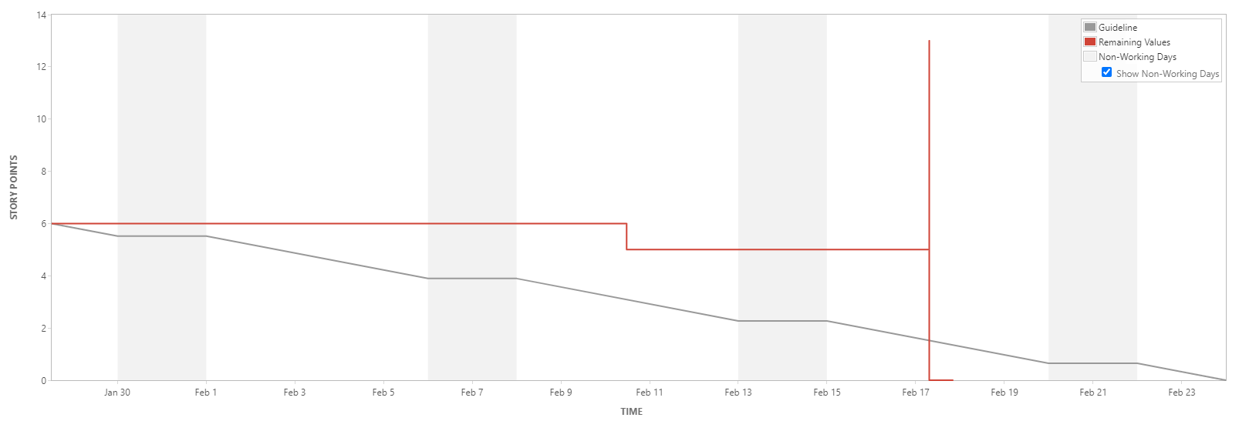
Sprint 5 Burndown Chart
We originally planned for 6 story points to be completed
We added the 8 story point mid sprint which caused the spike
We finished our work ahead of schedule
HiddenAgility

Slide 39
Sprint 6 Artifacts
78%
Completed Artifacts
1
Velocity
Type | Key | Summary | Story Points | Priority | Status
Story | HID-59 | As a patient, I want to include other symptoms along with my image upload so that I can receive a better diagnosis of my illness | 5 | Highest | Moved to Sprint 7
Task | HID-84 | Find 200 images of ringworm | N/A | High | Done
Task | HID-73 | Develop a python script to clear media folder OR implement a database for uploaded pictures | N/A | High | Moved to Sprint 8
Sub-task | HID-86 | Come up with FAQ | N/A | Medium | Done
Task | HID-85 | Create Mock-ups for new SymCheck Design | N/A | Medium | Done
Story | HID-81 | As a patient, I want to access a FAQ page so that I can see answers to common questions that I may have | 1 | Low | Done
Task | HID-77 | Update GitHub wiki | N/A | Low | Done
Task | HID-76 | Update Technical Paper | N/A | Low | Done
Task | HID-75 | Update installation guide and user manual | N/A | Low | Done
Task | HID-70 | Create a presentation for Sprint 6 | N/A | Lowest | Done
We created an FAQ page and designed wireframes for our new SymCheck design
We found 200 images of ringworm to train our machine learning algorithm
We moved our advance prediction user story to Sprint 7
We moved the development of a script or database to clear uploaded images to Sprint 8
HiddenAgility

Slide 40
Sprint 6 Test Cases
100%
Completed Artifacts
Test Case For | Key | Test Cases | Expected Results | Actual Results | Pass/Fail
FAQPage | HID-81 | Questions and Answers | Patient can see listed questions and respective answers | Patient sees listed questions and respective answers | Pass
FAQPage | HID-81 | Return to Home | Patient can return to the homepage | At the top of the page within the NavBar when selecting Home, you are redirected to the homepage of Symcheck | Pass
FAQPage | HID-81 | New Diagnosis | Patient can access the image upload page | At the top of the page within the NavBar when selecting Upload, you are redirected to the homepage of Symcheck | Pass
FAQPage | HID-81 | Find Nearest ER | Patient can access the interactive map with nearest ERs shown | At the top of the page, under the NavBar there is a Nearest Emergency Room section. Where you can click the Nearest Emergency Room button and google maps pops up with Emergency Rooms nearby your location. | Pass
FAQPage | HID-81 | Chatbot | Patient can interact with SymBot and receive a response | SymBot responds on all patient inputs such as hello, what is chickenpox, how can I speak to creators of symcheck, etc. | Pass
FAQPage | HID-81 | NavBar | Patient can move to all pages on site using the NavBar | Click any link in NavBar and the user is redirected to the Home, Upload, FAQ, or About Us Page | Pass
HiddenAgility

Slide 41
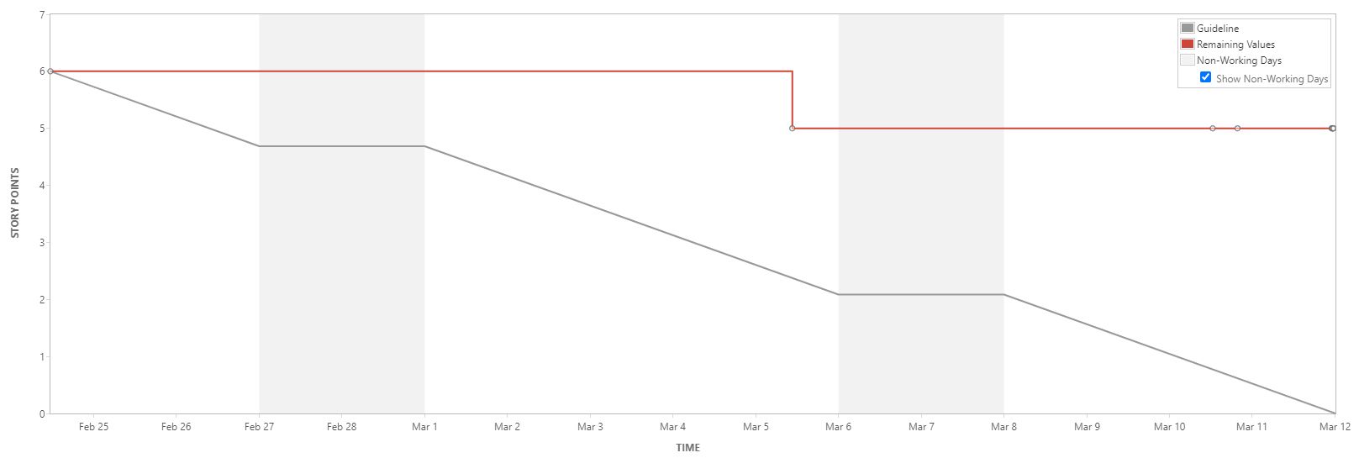
Sprint 6 Burndown Chart
The advance prediction page required more work than anticipated
We were only able to complete 1 story point because of this
HiddenAgility

Slide 42
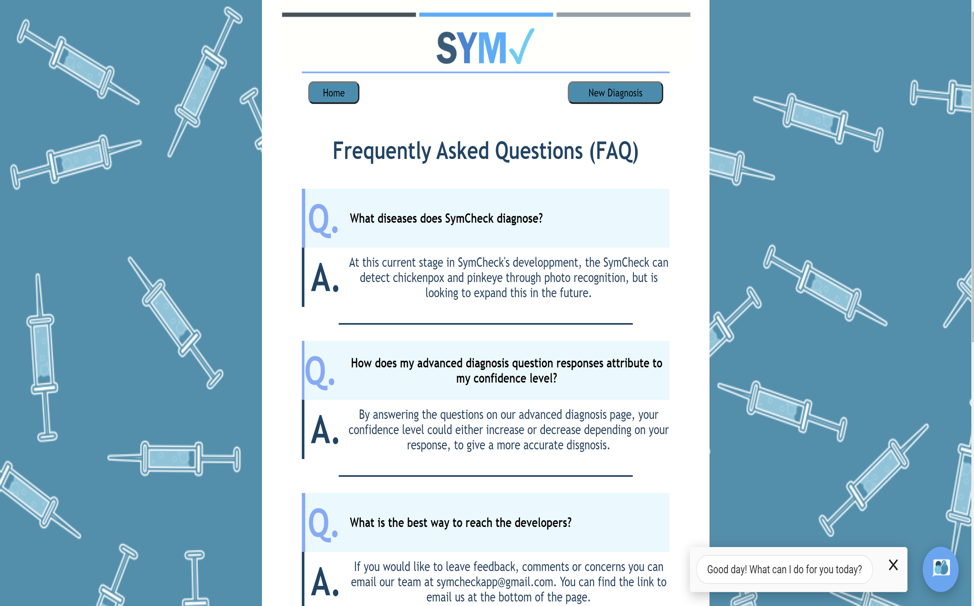
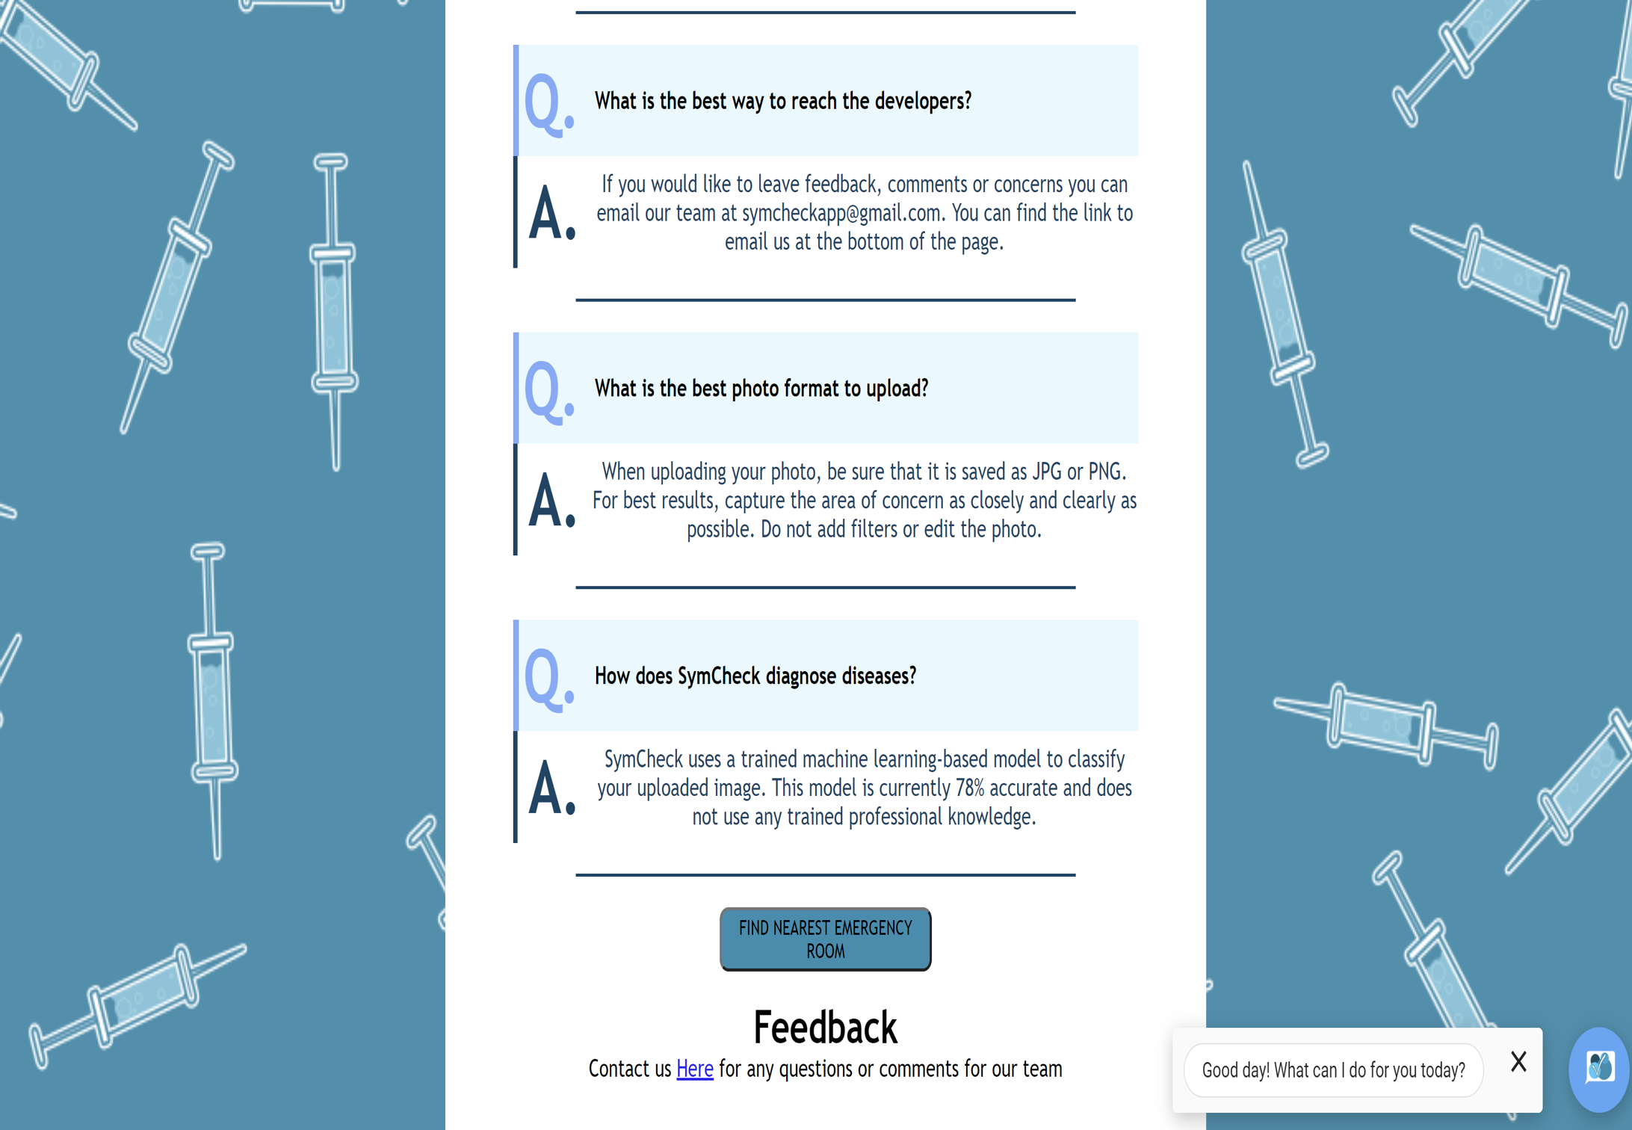
Sprint 6 Deliverable: FAQ Page
Top of Page
Bottom of Page
HiddenAgility

Slide 43
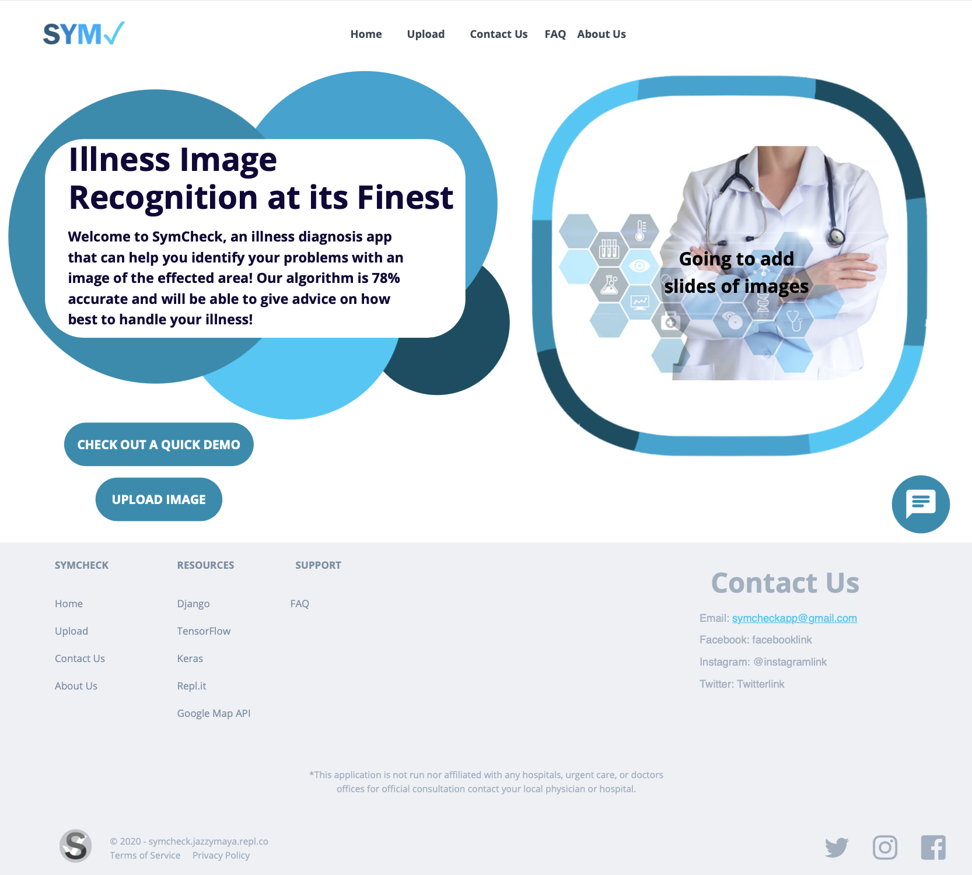
Sprint 6 Deliverable: Mock-up SymCheck Design
Homepage
HiddenAgility

Slide 44
Sprint 7 Artifacts
100%
Completed Artifacts
10
Velocity
Type | Key | Summary | Story Points | Priority | Status
Story | HID-59 | As a patient, I want to include other symptoms along with my image upload so that I can receive a better diagnosis of my illness | 5 | Highest | Done
Task | HID-94 | Every member is required to log work done every weekday | N/A | High | Done
Task | HID-83 | Redo SymCheck's application design | N/A | High | Done
Story | HID-82 | As a patient, I want to access other pages on the site with a navigation bar so that I can easily move from page to page | 3 | High | Done
Story | HID-93 | As a patient, I want to access an About Us page so that I can get to know more about the SymCheck creators | 1 | Medium | Done
Task | HID-80 | Add a disclaimer at the bottom of each page | N/A | Low | Done
Story | HID-79 | As a patient, I want to know which illnesses SymCheck can diagnose so that I know what I can upload. | 1 | Low | Done
Task | HID-71 | Create a presentation for Sprint 7 | N/A | Lowest | Done
We redesigned SymCheck with the inclusion of a navigation bar
We completed the Advance Page Prediction logic
HiddenAgility

Slide 45
Sprint 7 Test Cases (Advance Prediction Page)
100%
Completed Artifacts
Test Case For | Key | Test Cases | Test Data | Expected Results | Actual Results | Pass/Fail
Advance Prediction Page | HID-59 | Directed to Advance Prediction |  | Patient will be directed to Advance Prediction Page after submitting photo | After submitting a photo for analysis, the Advance Prediction Page will appear | Pass
Advance Prediction Page | HID-59 | Chickenpox | chickenpox image file | Patient will be asked questions about chickenpox | After submitting a chickenpox photo, the questions on the Advance Prediction are based upon this illness. | Pass
Advance Prediction Page | HID-59 | Pink Eye | pink eye image file | Patient will be asked questions about pink eye | After submitting a pink eye photo, the questions on the Advance Prediction are based upon this illness. | Pass
Advance Prediction Page | HID-59 | Complete All Answers |  | Patient will have to complete all answers | When choosing to answer the advanced questions must answer all of them to submit and move on to the results. If you don't answer one question an alert will pop up to answer that question | Pass
Advance Prediction Page | HID-59 | Submit Answers |  | Patient can submit answers to Advanced Questions | Once completing all questions, you can submit the answers to help further diagnosis your illness. | Pass
Advance Prediction Page | HID-59 | Skip to Results |  | Patient can skip Advance Questions and go to Results Page | If someone doesn't want to answer the Advanced Page questions, then clicking the skip to results button will send them to the results page | Pass
HiddenAgility

Slide 46
Sprint 7 Test Cases (About Us Page)
100%
Completed Artifacts
Test Case For | Key | Test Cases | Test Data | Expected Results | Actual Results | Pass/Fail
About Us Page | HID-59 | About Us | N/A | Patient can locate About Us page | In the NavBar you will find About Us, once selected you will be redirected to this page | Pass
About Us Page | HID-59 | What is SYMCheck | N/A | Patient can see what SYMCheck Application does | Underneath the NavBar you will see a short description about what the application does | Pass
About Us Page | HID-59 | Meet the Team | N/A | Patient can see all of the team members who created SYMCheck | Below the What is SYMCheck section you will see Meet the Team. With a list of our team members with pictures and the description of our roles. | Pass
About Us Page | HID-59 | Chatbot | How can I get in touch with developers? | Patient can interact with SymBot and receive a response | SymBot responds on all patient inputs such as hello, what is chickenpox, how can I speak to creators of symcheck, etc. | Pass
HiddenAgility

Slide 47
Sprint 7 Test Cases (All Pages)
100%
Completed Artifacts
Test Case For | Key | Test Cases | Expected Results | Actual Results | Pass/Fail
Homepage | HID-79 | Illness Diagnosed | Patient can see which illnesses SymCheck can check for | Patient can see what illnesses SymCheck can diagnose as well as its machine learning accuracy percentage | Pass
All Pages | HID-80 | Disclaimer | Patient can see disclaimer in the footer | In the footer, there is a disclaimer saying we are not medical professionals | Pass
All Pages | HID-80 | Footer Links | Patient can click on any links in footer and be redirected to respective pages | In the footer, all links under SymCheck, Resources, Support, and Contact Us take you to the correct page | Pass
All Pages | HID-82 | Navigation Bar | Patient can move to all pages that does not rely on user input on site using Navigation bar | Patient can click any link in Navigation Bar and is redirected to the Home, Upload, FAQ, or About Us Page | Pass
All Pages | HID-83 | Footer | Patient can access footer along all pages throughout the web application | On every page, the patient has access to the same footer elements | Pass
HiddenAgility

Slide 48
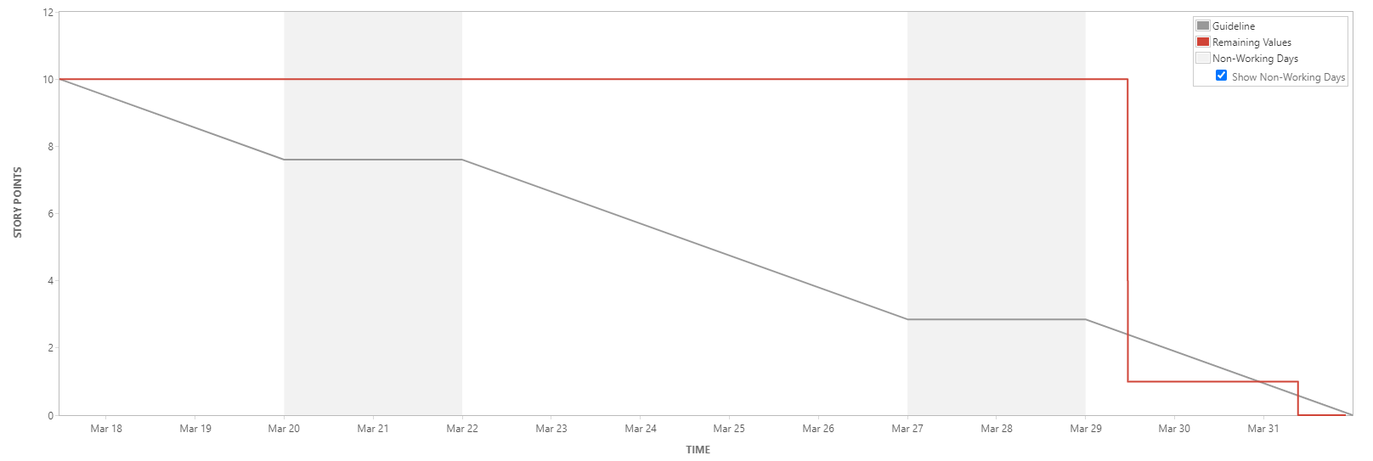
Sprint 7 Burndown Chart
Most of the team’s efforts went into the complete redesign of SymCheck
We finished our work towards the end of the Sprint

Slide 49
Sprint 7 Deliverable: Redesign
After
Before

Slide 50
Sprint 7 Deliverable: Advance Prediction Page - Chickenpox

Slide 51
Sprint 8
HiddenAgility

Slide 52
Sprint 8 Statistics
78%
Completed Artifacts (Tasks and Stories)
16
Velocity
Type | Key | Summary | Story Points | Priority | Status
Story | HID-62 | As a patient, I want to access the SymCheck application on the web so that I don't have to download and run an instance myself | 8 | Highest | Done
Task | HID-88 | Set up AWS environment for development and production | N/A | High | Done
Task | HID-78 | Add ringworm as another illness that can be predicted | N/A | High | Incomplete
Task | HID-73 | Develop a python script to clear media folder OR implement a database for uploaded pictures | N/A | High | Incomplete
Story | HID-64 | As a patient, I want to access SymCheck on my mobile device for convenience | 5 | High | Done
Task | HID-100 | Code initially with optimization in mind | N/A | Medium | Done
Sub-task | HID-99 | Develop ringworm logic for views.py | N/A | Medium | Incomplete
Sub-task | HID-98 | Add ringworm information to results page | N/A | Medium | Incomplete
Sub-task | HID-97 | Add ringworm questions to Advance page | N/A | Medium | Incomplete
Task | HID-96 | Optimize SymCheck code | N/A | Medium | Done
Story | HID-95 | As a patient, I want to be able to easily understand my illness is so that I know how serious it is | 3 | Medium | Done
Sub-task | HID-92 | Create AWS S3 bucket | N/A | Medium | Done
Sub-task | HID-91 | Create AWS Elastic Beanstalk instance | N/A | Medium | Done
Sub-task | HID-90 | Create IAM roles for team and provide access to instances | N/A | Medium | Done
Sub-task | HID-89 | Create a Cloud9 development environment in AWS | N/A | Medium | Done
Task | HID-72 | Create a presentation for Sprint 8 | N/A | Lowest | Done
AWS Cloud Deployment was successful
Did not add Ringworm as another illness prediction
HiddenAgility

Slide 53
Sprint 8 Artifacts
HID-62 User Story Points: 8
HID-64 User Story Points: 5
HID-95 User Story Points: 3
As a patient, I want to access the SymCheck application on the web so that I don't have to download and run an instance myself
Acceptance Criteria: Given that the patient opens a supported browser, when the patient navigates to www.symcheckapp.com, then the patient can utilize SymCheck
As a patient, I want to access SymCheck on my mobile device for convenience
Acceptance Criteria: Given that the patient is on a mobile device using a supported browser, when the patient navigates to www.symcheckapp.com, then the patient will see a mobile friendly interface
As a patient, I want to be able to easily understand my illness is so that I know how serious it is
Acceptance Criteria: Given that the patient is on the Results page, when the patient receives a diagnosis, then the patient will see a progress bar showing their percentage
HID-88 Task
HID-100 Task
HID-72 Task
HID-96 Task
Create a presentation for Sprint 8
Set up AWS environment for development and production
Optimize SymCheck code
Code initially with optimization in mind
HiddenAgility

Slide 54
Sprint 8 Test Cases
87%
Completed Artifacts
Test Case For | Key | Test Cases | Test Data | Expected Results | Actual Results | Pass/Fail
Results | HID-95 | Progress Bar | Normal Eye or Normal Skin | Patient will be able to easily understand how serious the illness is | When completing results if patient has a Normal Eye or Normal Skin with a percentage of 66% of higher then the progress bar is green. Otherwise if the percentage is less than 66% ten the progress bar is yellow. | Pass
Results | HID-95 | Progress Bar | Pink Eye or Chickenpox | Patient will be able to easily understand how serious the illness is | When completing results if patient has a Pink Eye or Chickenpox with a percentage of 66% of higher then the progress bar is red. Otherwise if the percentage is less than 66% ten the progress bar is yellow. | Pass
Mobile | HID-64 | Home Buttons | Upload Images and Check Out A Quick Demo | Patient will be redirected to button links once they are clicked | Clicking on the Check Out A Quick Demo button the user is redirected to a video to show a demo of how to use the website. Clicking on the Upload Images button the user will be redirected to the Upload page where they can upload images for diagnosis | Pass
Mobile | HID-64 | Chatbot | Hi, chicken pox, pink eye, How can I get in touch with the Developers of SymCheck?, How do I upload an image? | Patient can interact with SymBot and receive a response | SymBot responds on all patient inputs such as hello, what is chickenpox, how can I speak to creators of symcheck, etc. | Pass
Mobile | HID-64 | NavBar | Home, Upload, FAQ, Advanced, Results, and About Us Pages | Patient can move to all pages on site using the NavBar | Click any link in NavBar and the user is redirected to the Home, Upload, FAQ, or About Us Page | Pass
Mobile | HID-64 | Locate the Nearest ER Link | Upload, FAQ, and Results Pages | Patient should be able to locate and click the Nearest ER link to access an interactive map | Under the NavBar, there is the Nearest ER link. Clicking this button, you can access google maps to show hospitals nearby. | Pass
Mobile | HID-64 | Patient Input Page | Chickenpox.png | Patient should be able to click submit to send correct photo to be analyzed | Once uploading the image click the submit button and the algorithm begins analyzing the photo for results. **Only for files under 1MB** | Fail
Mobile | HID-64 | Results |  | Patient will see percentage that they have the illness | In the Results section it displays the likely hood of the uploaded image being an illness. | Pass
HiddenAgility

Slide 55
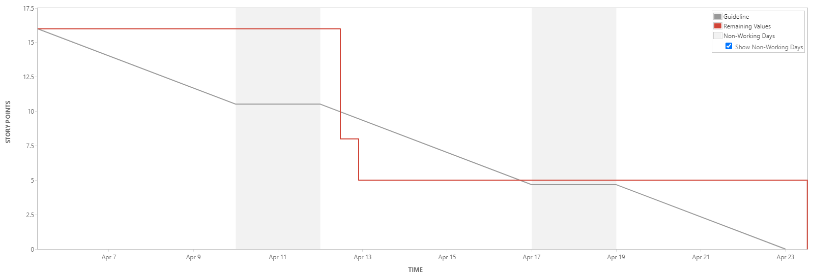
Sprint 8 Burndown Chart
We completed cloud deployment mid sprint.
We finished SymCheck’s mobile responsiveness at the end.
HiddenAgility

Slide 56
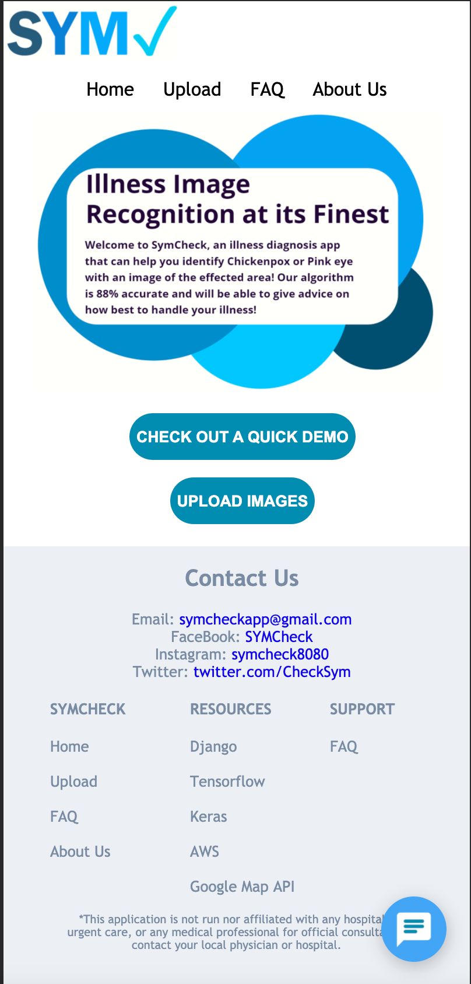
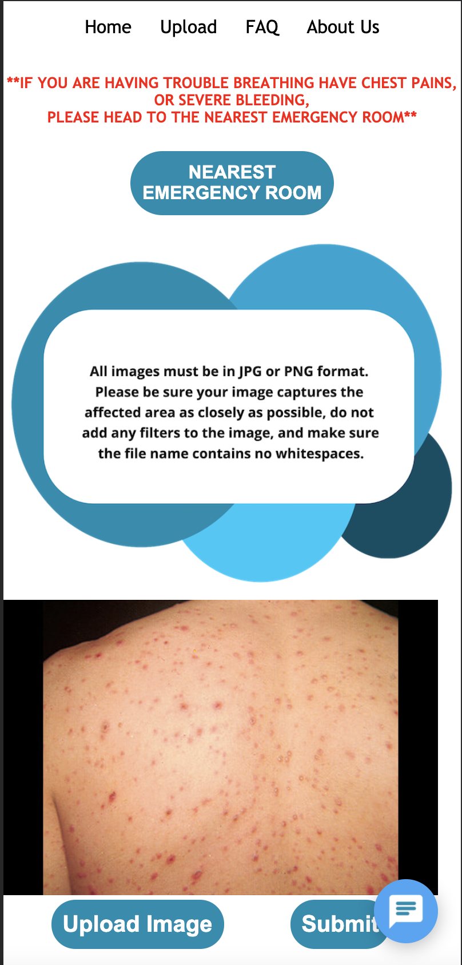
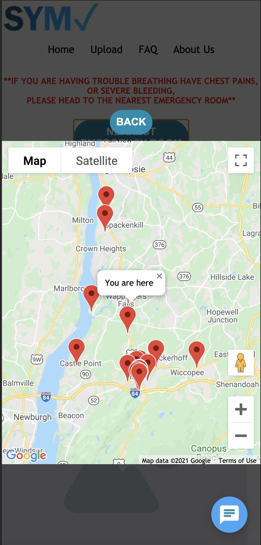
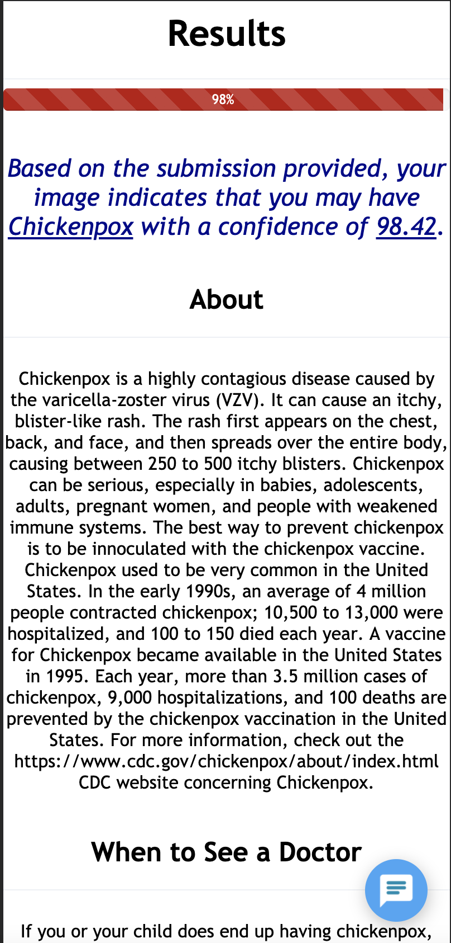
Sprint 8 Deliverables
Homepage
Upload Page
Nearest Emergency Room
Results Page
HiddenAgility

Slide 57
Retrospectives
HiddenAgility

Slide 58
Retrospectives
What went well
Using Code Collaboration AWS Cloud 9 tool
Coding with optimization in mind
4
1
1
What needs improvement
Implementing daily scrum principles
Improve pair programming
Daily scheduled working time
Implementing daily scrum principles
Next Steps
HiddenAgility

Slide 59
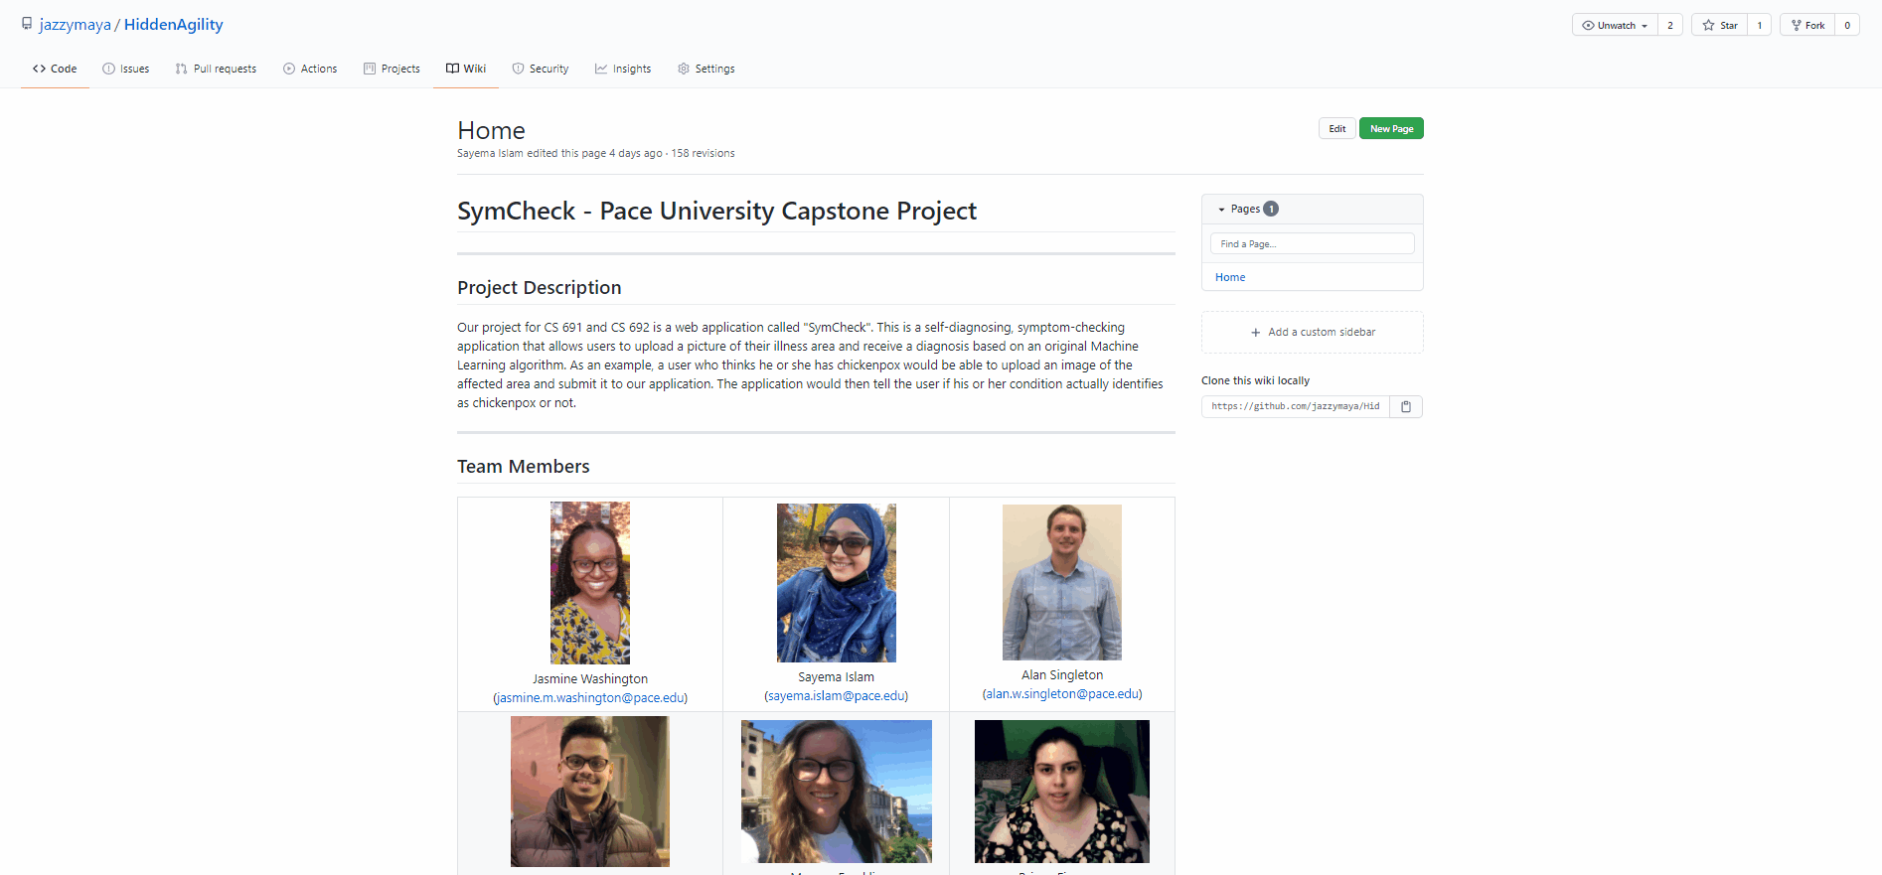
GitHub Wiki
https://github.com/jazzymaya/HiddenAgility/wiki
HiddenAgility

Slide 60
Conclusion
HiddenAgility

Slide 61
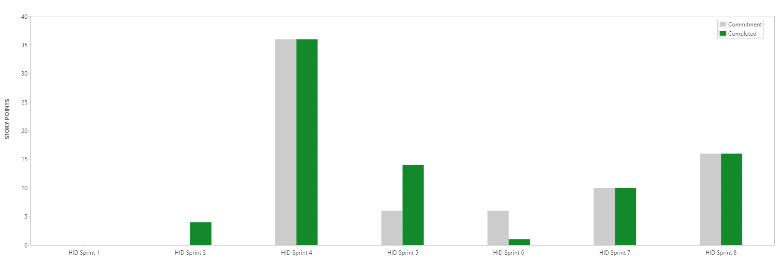
Conclusion
Velocity Chart
HiddenAgility

Slide 62
Conclusion
SymCheck Recap
Visit https://symcheck.msjasmine.repl.co on your desktop or from your mobile device today
www.symcheckapp.com URL will be deprecated May 10th, 2021. Repl.it has upgraded their servers so we will maintain SymCheck on their infrastructure
Follow SymCheck on Facebook, Instagram, and Twitter to stay up-to-date on all things SymCheck
Future Scope
Addition of illnesses for diagnoses
Increasing the accuracy of training within our backend image classification model
Implementation of a dynamic script to clear media folder of all user image uploads daily for increased patient privacy
HiddenAgility

Slide 63
Thank you!
HiddenAgility

Slide 64
Demo
HiddenAgility

Slide 65
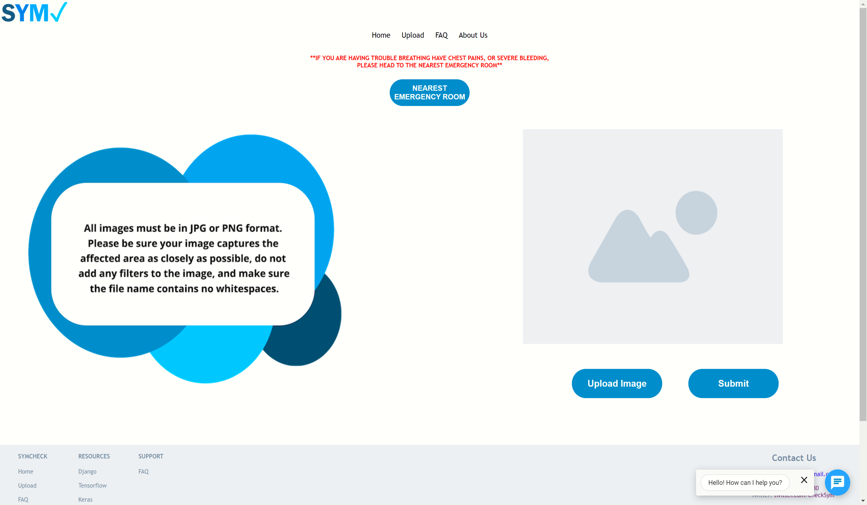
Demo Screen Shots
Check out our demo video
HiddenAgility

